Slide 1
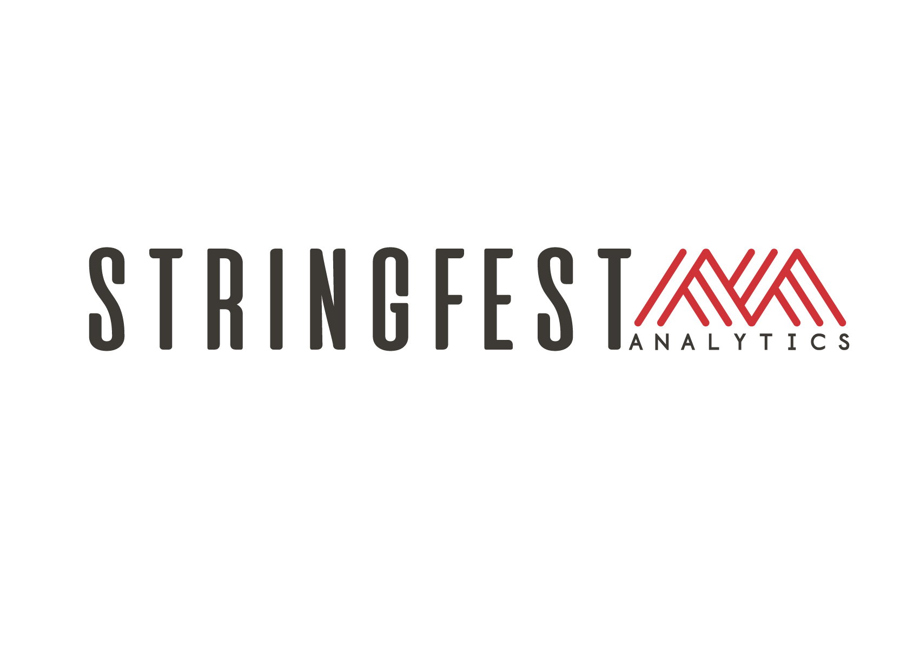

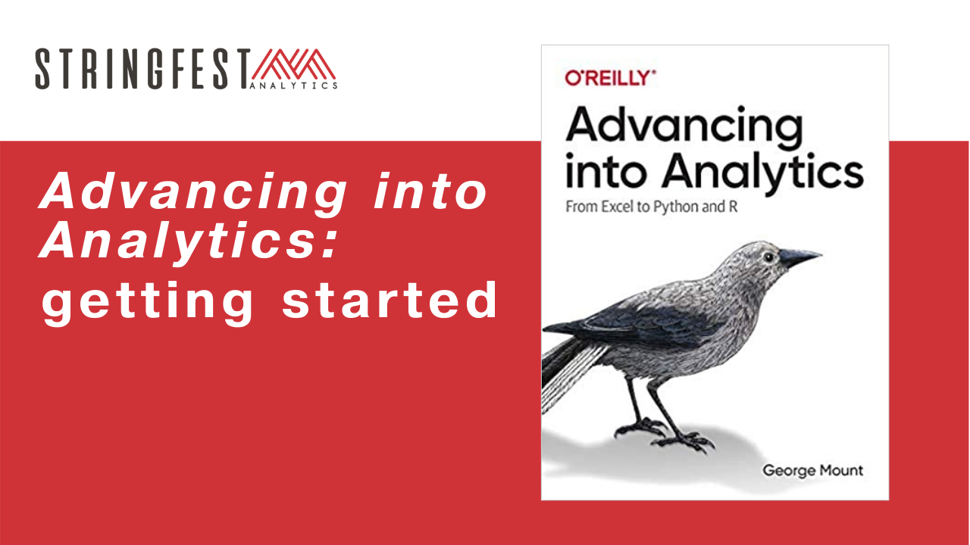
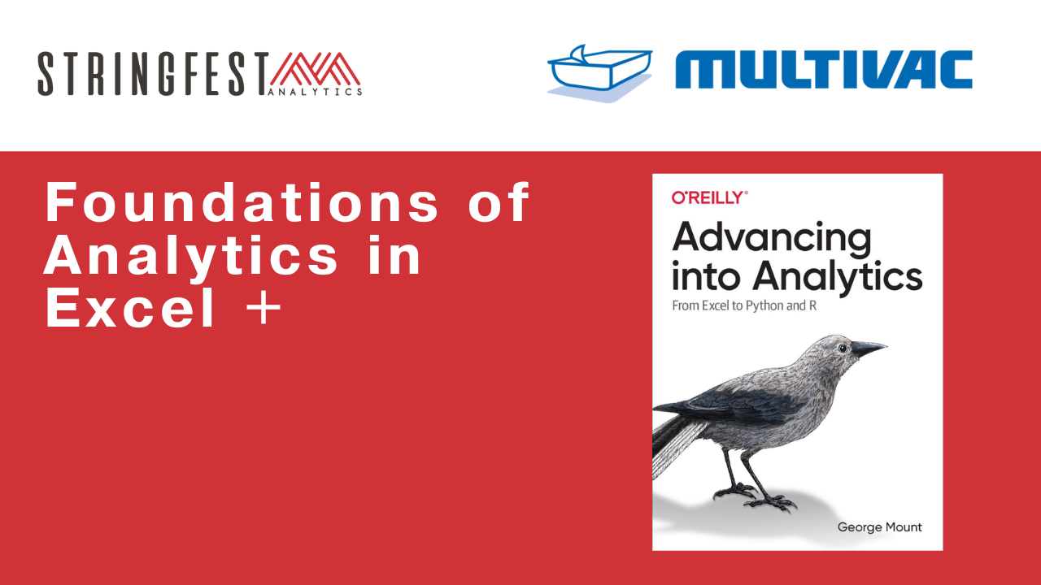
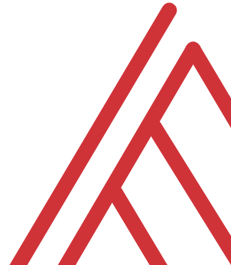
Advancing into Analytics: From Excel to R and Python

Slide 2
Follow along
Download resources: https://github.com/stringfestdata/foundations-analytics-excel-multivac

Slide 3
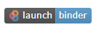
Follow along
Download and unzip resources: https://github.com/stringfestdata/python-for-excel-users-crash-course
Follow along …. →

Slide 4
Questions?
Notes:
Any questions so far about using R?
Again I just want to show you how easy it is to get up and running there as an Excel user and what to expect when working with open source programs.
Now I guess one of the questions I might have in your shoes is what’s the big deal, we can do the same kind of stuff with Power Query. So I want to acknowledge that.

Slide 5
Objectives for today
Clean data in Excel
Analyze it in Excel
Script it all in Python
Notes:
So this means anyone is free to build on it or redistribute it… and that’s how we’ll get our code

Slide 6
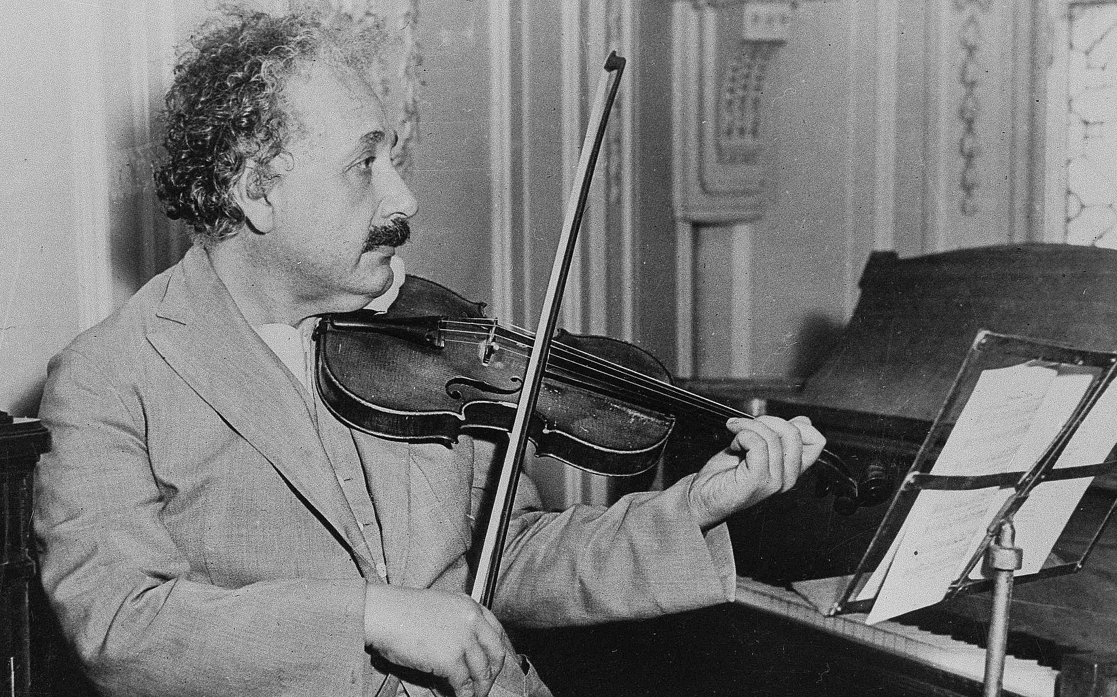


3 Fun Facts about me
Like Einstein in this one way…
My Duolingo jam
This was never me…
Notes:
So this means anyone is free to build on it or redistribute it… and that’s how we’ll get our code

Slide 7
~3 Fun Facts about you
… plus your learning objectives
Notes:
So this means anyone is free to build on it or redistribute it… and that’s how we’ll get our code

Slide 8
Tentative schedule
Notes:
So this means anyone is free to build on it or redistribute it… and that’s how we’ll get our code

Slide 9
Questions?
Who wants to win a book?
Notes:
Any questions so far about using R?
Again I just want to show you how easy it is to get up and running there as an Excel user and what to expect when working with open source programs.
Now I guess one of the questions I might have in your shoes is what’s the big deal, we can do the same kind of stuff with Power Query. So I want to acknowledge that.

Slide 10
Excel to Python (and back)

Slide 11
1. Open source means a license to build and distribute
Notes:
This is different coming from Microsoft, proprietary technology
Python is open source what does that mean?

Slide 12

What is open source?
“… code that is designed to be publicly accessible—anyone can see, modify, and distribute the code as they see fit.”
- Red Hat, “What is open source?”
https://cloudblogs.microsoft.com/windowsserver/2015/05/06/microsoft-loves-linux/
Notes:
So this means anyone is free to build on it or redistribute it… and that’s how we’ll get our code

Slide 13



Python+ Anaconda + Jupyter
The (open) source code
python.org
The “distribution” of code & apps
anaconda.com
The browser-based app
jupyter.org
Notes:
OK now remember that being open source means anyone is free to repackage and redistribute code. In the case of Python the official source code lives with the Python foundation and can be found there. It’s more common however to download from the Anaconda _distribution_ of that code. One of the reasons why is Anaconda comes with some goodies that don’t come with the raw Pyhon installation. One of those is the Jupyter notebook, which is a browser-based app we’ll be using to work with Python.

Slide 14

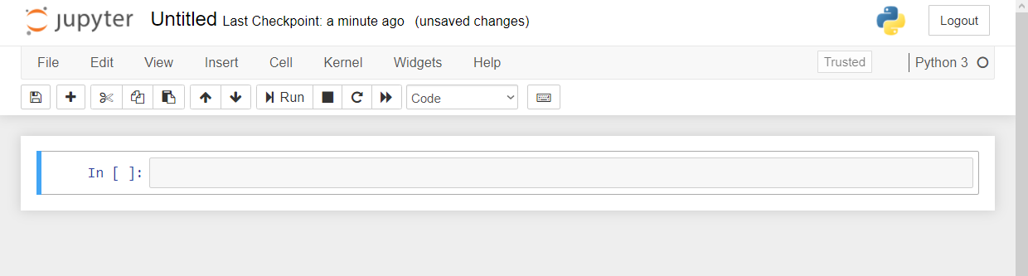

Demo
File: downloading-anaconda.docx
Download Anaconda (or click “launch binder”…)
Start with Jupyter at 1+1…
Menu bar
Toolbar
Code cell
Notes:
OK again, what I want to do here is just show you the basics of working with Jupyter. You will see in the repo there is an option to launch an interactive session, so do that and let’s navigate the four sections of Jupyter and get comfortable working there.
In the demo you’ll get a tour of the notebook and how to work a bit with functions and objects.
Possibly come up with some demo notes for this

Slide 15
2. It’s finnicky… or maybe logical?

Slide 16
Demo
File: thing-2.ipynb
How does Python handle
Case sensitivity?
Indexing?
Whitespace?
Notes:
OK so what we are going to do here is go back to your session or open a new one. Go to the diamonds.r dataset. And let’s actually conduct the analysis that was hinted at earlier.

Slide 17
3. There’s a package for that!

Slide 18

The package two-step…
Install the package if needed
conda install packagename
pip install packagename
Open the package
import packagename
More: https://stringfestanalytics.com/sourcing-python-packages/
Notes:
Now another thing unique to open source programs is this idea of packages. You can kind of think of this as like add-ins for Excel – the analogy I like to use is as apps on a phone.

Slide 19
You won’t get far without these…
Package | Description
numpy | Designed for numerical computing
pandas | Designed to work with panel data and other tabular data structures (think rows and columns. This package leverages code from numpy.
matplotlib | a popular package for data visualization
seaborn | another package for data visualization, built on top of matplotlib and designed to work well with pandas.

Slide 20
Demo
File: thing-3.ipynb
Import from the Standard Library
Confirm packages available to you
Import and alias pandas
Notes:
OK again, what I want to do here is just show you the basics of working with Jupyter. You will see in the repo there is an option to launch an interactive session, so do that and let’s navigate the four sections of Jupyter and get comfortable working there.
Possibly come up with some demo notes for this

Slide 21
Questions?
Who wants to win a book?
Notes:
Any questions so far about using R?
Again I just want to show you how easy it is to get up and running there as an Excel user and what to expect when working with open source programs.
Now I guess one of the questions I might have in your shoes is what’s the big deal, we can do the same kind of stuff with Power Query. So I want to acknowledge that.

Slide 22
4. It can augment and automate Excel

Slide 23
So many choices, so many use cases…
Package | Pros | Cons
xlsxwriter | Write almost anything from Excel from Python (data, formats, workbook settings, etc.) | Writes to Excel only/no reading
xlwings | Feature-rich: write data/UDFs, call VBA procedures, robust debugging tools | Local Python/Excel downloads needed
openpyxl | Read and write .xlsx, .xlsm Excel files | Limited ability to edit files
pyxlsb | Read and write .xlsb files | Limited features
xlrd, xlwt, xlutils | Can work with .xls files | Limited features
Notes:
Now another thing unique to open source programs is this idea of packages. You can kind of think of this as like add-ins for Excel – the analogy I like to use is as apps on a phone.

Slide 24
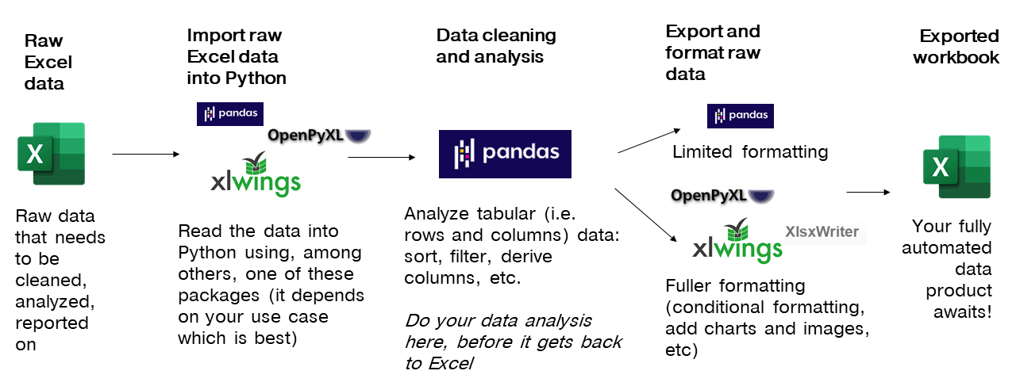
Notes:
Now another thing unique to open source programs is this idea of packages. You can kind of think of this as like add-ins for Excel – the analogy I like to use is as apps on a phone.

Slide 25
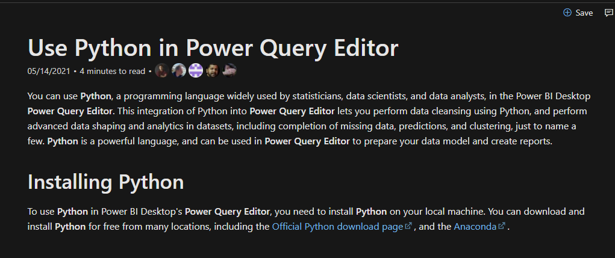
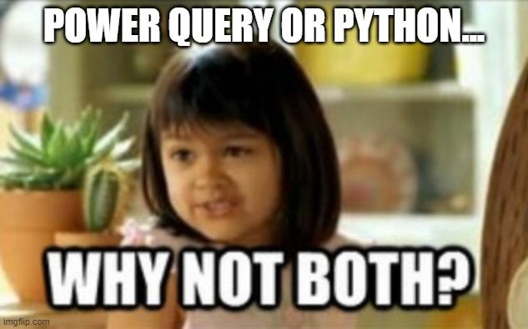
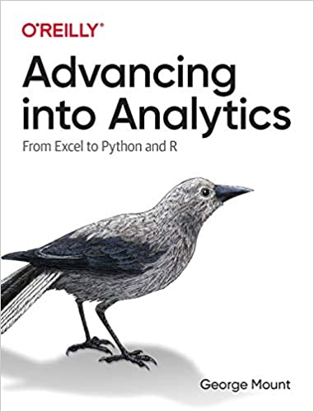
You’re not leaving the stack…
Notes:
One of the things that people get confused about is why learn Python if you’re getting into Power Query… or which to focus on.
You’re not leaving Microsoft’s stack. I have some documentation and a great book here. Now of course these are more about PowerBI but there’s every indication there’s more to come with Excel.

Slide 26
5. It’s not worth panicking over
Notes:
Now this is scary, it’s literally learning another language!

Slide 27
Demo
File: thing-5.ipynb
Some ways to get help from right inside Jupyter…
Notes:
OK again, what I want to do here is just show you the basics of working with Jupyter. You will see in the repo there is an option to launch an interactive session, so do that and let’s navigate the four sections of Jupyter and get comfortable working there.
Possibly come up with some demo notes for this

Slide 28
Conclusion/Resources

Slide 29


Let’s play DataBaseball!
2. Profile the data
3. Analyze the data
1. Import the data
4. Export results to Excel
Notes:
Start by: 9:35
Link to notebook: https://github.com/summerofgeorge/modal-python-da/blob/main/modal-python-big-picture.ipynb
Read in data from Sean Lahman’s baseball database
Visualize and explore records – what does this data look like? What can it tell us? What do we need to do to get it clean?
Salary analysis: Do higher payrolls attract larger crowds?
Produce presentation-worthy Excel summary workbook from Python

Slide 30
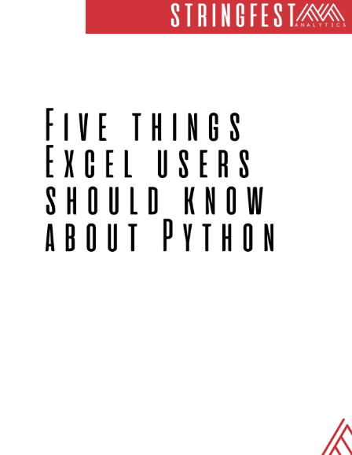
Free white paper
Five Things Excel Users Should Know About Python:
https://stringfestanalytics.com/five-things-python-excel/
Notes:
By the end of this book, you should be able to conduct exploratory data analysis and
hypothesis testing using a programming language.

Slide 31
Want more?
Read Advancing into Analytics: https://stringfestanalytics.com/book/
Read for free on O’Reilly’s website
Or pick up a paperback/ebook
Please leave a review!
Notes:
By the end of this book, you should be able to conduct exploratory data analysis and
hypothesis testing using a programming language.

Slide 32
THANK YOU
george@stringfestanalytics.com
linkedin.com/in/gjmount
stringfestanalytics.com/contact

